Slide 1
Coursera Capstone
Final Project Presentation

Slide 2
Objectives
The main aim of this report is to use all the concept we’ve learned from the previous courses for solving a business problem where we can use the Foursquare location data.
The objective of this project is to find the best neighbourhood in Toronto to open a Gym using foursquare location data to analyse a little bit the current location of the gyms.

Slide 3
Data acquisition and cleaning
For this project we need the following data:
Toronto City data (Boroughs, Neighbourhoods)
https://en.wikipedia.org/wiki/List_of_postal_codes_of_Canada:_M
Wikipedia contains all the information we need to explore and cluster the neighbourhoods in Toronto. We will be required to web scrape the Wikipedia page and wrangle the data, clean it, and then convert it into a pandas dataframe
Geographical Location data using Geocoder Package
https://cocl.us/Geospatial_data
The second source of data provided us with the Geographical coordinates of the neighborhoods with the respective Postal Codes.

Slide 4
Data acquisition and cleaning
Venue Data using Foursquare API
https://foursquare.com/developers/apps
From Foursquare API we can get the name, category, latitude, longitude for each venue.

Slide 5
Methodology
The following assumptions were made
Ignore cells with a borough that is not assigned.
More than one neighbourhood can exist in one postal code area. For example, in the table on the Wikipedia page, you will notice that M5A is listed twice and has two neighbourhoods: Harbourfront and Regent Park. These two rows will be combined into one row with the neighbourhoods separated with a comma as shown in row 11 in the above table.
If a cell has a borough but a not assigned neighbourhood, then the neighbourhood will be the same as the borough.

Slide 6
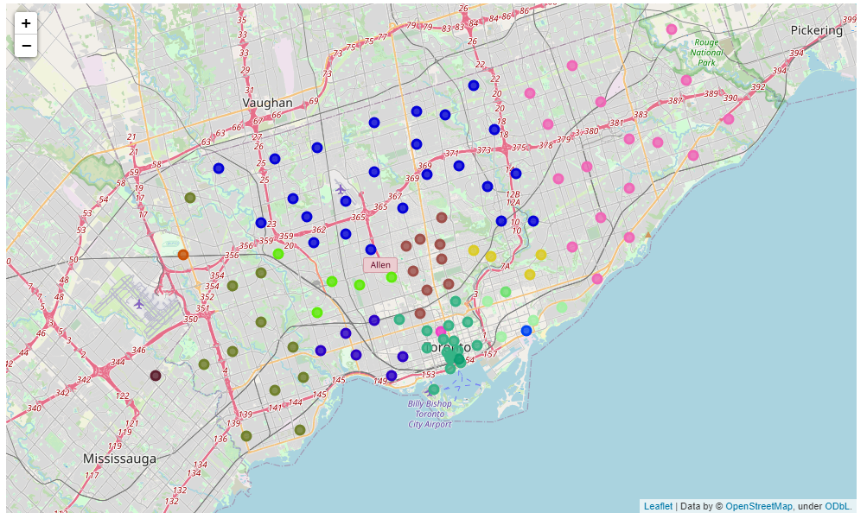
Venues in Toronto City

Slide 7
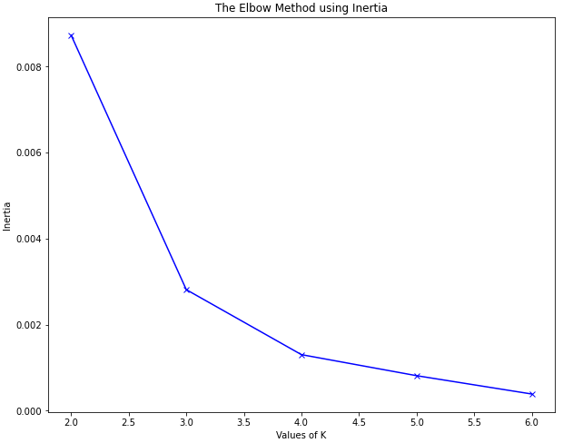
K-Means Clustering
There was a total of 102 gyms in Toronto
We use the K-Means technique to label each gym in one category
Most optimal values of “k”: 4

Slide 8
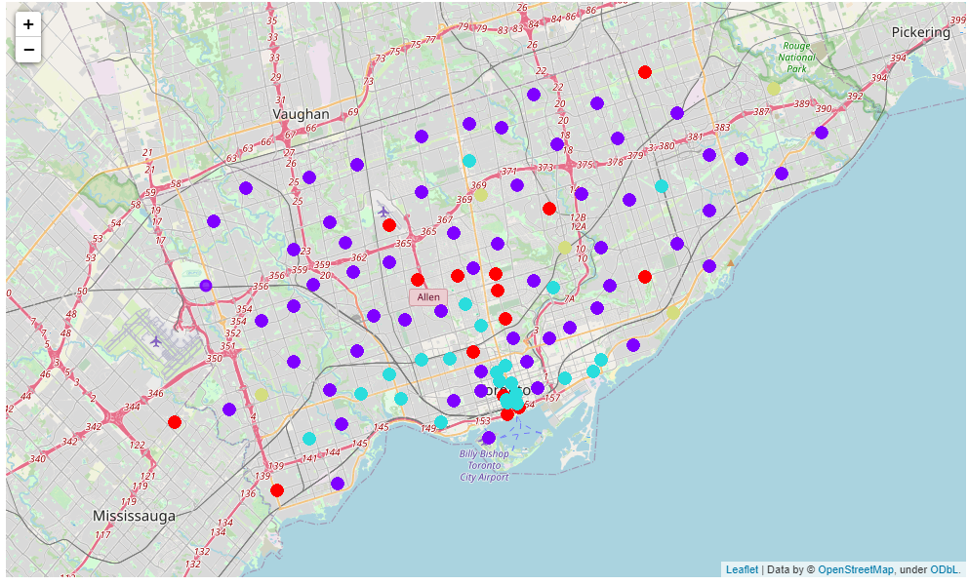
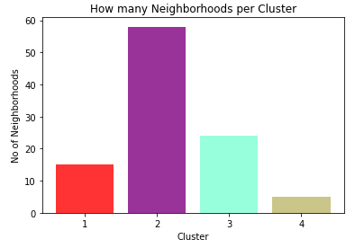
Result & Outcomes

Slide 9
Conclusion
In conclusion, to end off this project, we had an opportunity to analyse a little bit a business problem. This is only the beginning, because there are more work to do after obtaining this information, such as analyse more deeply with this information the best place to put a gym or what type or gym are more profitable depends of the neighbourhood. This is only an insight of how we can solve a real world problem.

Slide 10
The End
Thank you very much for the attention!

